Slide 1








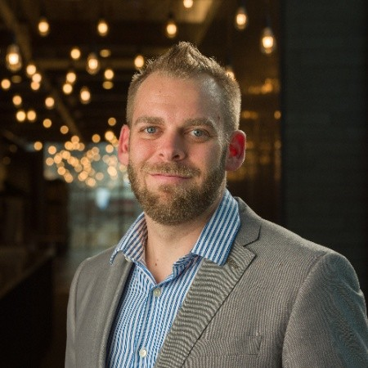
Insert
State seal
State of _______
Power Platform Roundtable
You’re invited to _______’s Power Platform Roundtable, a series of educational presentations and demonstrations of Microsoft’s Power Platform: Power Apps, Power Automate, and Power BI.
Each session will consist of a presentation, technical demo, and time for discussion and collaboration. The only prerequisite to join is a curious attitude and an open mind.
Power Apps
Power Automate
Power BI
Dynamics 365
Power Virtual Agents
Thursday, December 2nd – 10:00 AM – 12:00 PM MDT
We will be exploring Microsoft’s no-code chatbot development framework, Power Virtual Agents, in this upcoming session. I will demonstrate:
Developing a public-facing chatbot for assisting citizens in applying for a ground water well permit
Connecting this chatbot to Dataverse via Power Automate
Deploying this chatbot to our public-facing portal
Presented By
Tim Hanewich
Technical Specialist
Dustin Knudson
Solution Specialist

